Slide 1
Databases
Bugsmashers

Slide 2

Database:
A set of data held in a computer. It can be used in many ways, such as data analysis, storage, and management.
Notes:
ANDREW

Slide 3

ACID Properties
Atomicity
Consistency
Each transaction is a singular unit, so in case any part of the operation fails, there is no data loss
Each transaction only makes changes in predictable ways, reducing corruption from unintended consequences
Isolation
Durability
Each transaction does not affect each other. This ensures that a transaction to read/write only happens after a change (or not) is committed.
Each transaction result is permanently preserved. This prevents data from being lost in the case of a system failure.
Notes:
ANDREW

Slide 4
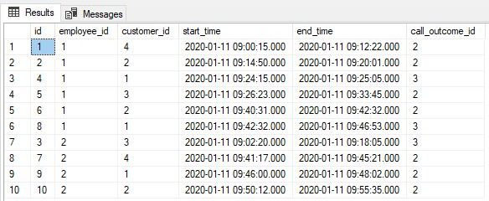
SQL Example
Notes:
ANDREW

Slide 5
sqlite tutorial
Step 1: Connect to a database, starts an interactive session.
sqlite3 [path_to_db_file]
Step 2: Run your sql queries
Ex: SELECT * FROM Table;
If you get stuck on the …> prompt, sqlite3 is waiting for you to finish your SQL query.
Remember to end your SQL query with a semicolon.
Step 3: Disconnect from the database with .exit or .quit
Notes:
JOHN

Slide 6
SQL Keywords Examples
SELECT [column] | Selects data from a table (shows you the data)
FROM [table] | Specifies which table to obtain data from
WHERE [condition] | Used to filter output based on a condition
INSERT INTO [table], VALUES ([value]) | Used to add a new row to a table
UPDATE [table], SET [statement] | Changes values in a given row
ORDER BY, ASC/DESC | Sorts result in ascending or descending order
LIMIT [num] | Limits the output results to an amount
DELETE FROM [table] | Deletes rows from a table (be careful!)
DROP TABLE [table] | Deletes tables completely (be extremely careful!)
Most of these can accept multiple arguments in the tuple format: arg1, arg2, …
Notes:
JOHN
// create table
CREATE TABLE Artists (
artistName TEXT,
monthlyListeners INTEGER,
genre TEXT,
mostPopularTrack TEXT
); INSERT INTO Artists (artistName, monthlyListeners, genre, mostPopularTrack) VALUES
('Olivia Rodrigo', 65565052, 'Pop', 'vampire'),
('Travis Scott', 58151110, 'Hip-Hop/Rap', 'SICKO MODE'),
('Bad Bunny', 75589324, 'Reggaeton/Latin', 'Titi Me Preguntó'),
('The Weeknd', 73156120, 'R&B/Pop', 'Blinding Lights'),
('Ed Sheeran', 583509, 'Pop', 'Shape of You'),
('Ariana Grande', 34044, 'Pop', '7 Rings'),
('Post Malone', 435524, 'Hip-Hop/Pop', 'Sunflower'),
('Billie Eilish', 3, 'Pop', 'bad guy'),
('Kanye West', 79458743, 'Hip-Hop', 'Stronger'),
('Justin Bieber', 21409, 'Pop', 'Stay');
Samples:
// selecting all values from a table
SELECT * FROM Artists;
// introduce column formatting
.mode column
// selecting all values from a table that has their ONLY genre as 'Pop'
SELECT * FROM Artists WHERE genre = 'Pop';
// add another artist to the table
// ask audience
INSERT INTO Artists VALUES ('artist_name', 80085, 'genre', 'song');
// selecting names from the table, sorted descending by monthly listeners
SELECT artistName FROM Artists ORDER BY monthlyListeners DESC;
// what if I just want the top three artists?
SELECT artistName FROM Artists ORDER BY monthlyListeners DESC LIMIT 3;
// what if I want their monthly listener count there too?
SELECT artistName, monthlyListeners FROM Artists ORDER BY monthlyListeners DESC LIMIT 3;
// selecting all values from a table that has ‘Pop’ in their genre
// mention that LIKE is also case insensitive
// use % (wildcard character)
// explain * wildcard for unix
SELECT * FROM Artists WHERE genre LIKE '%pop';
// travis scott is now a classical artist
// how do we change the database
UPDATE Artists SET genre = 'Classical' WHERE artistName = 'Travis Scott';
// as a result, travis scott’s monthly listeners has increased by 100000000
// change his monthly listeners to reflect that
UPDATE Artists SET monthlyListeners = monthlyListeners + 100000000 WHERE artistName = 'Travis Scott';
// DELETE travis scott from the table
DELETE FROM Artists WHERE artistName = 'Travis Scott';
// why do I not need to specify a column, or use * like in SELECT * FROM …. ?
// delete all artists from the table
DELETE FROM Artists;
// delete the table
DROP TABLES Artists;

Slide 7
Revenue
 | Q1 | Q2 | Q3 | Q4 | Total
Product sales | 50000 | 60000 | 75000 | 90000 | 275000
Labor | 20000 | 24000 | 30000 | 36000 | 110000
Salaries | 15000 | 18000 | 20000 | 24000 | 77000
Marketing | 7000 | 8000 | 9000 | 10000 | 34000
Net income | 24500 | 26750 | 28000 | 34250 | 113500
Rent | 5000 | 5000 | 5000 | 5000 | 20000
Utilities | 1500 | 1750 | 2000 | 2250 | 7500

Slide 8
Example Statements:
SELECT Q1, Q2 FROM Revenue
SELECT * FROM Revenue WHERE Total > 70000

Slide 9
Column Restraints
Restraints in programming are good!
Think typing, encapsulation
If you assume values are good when they are collected (and don’t check them later), they might not actually be good when it comes time to store it in your database.
Multiple layers of security are good!
Notes:
JOHN

Slide 10
Column Restraints
NOT NULL | A column cannot have a NULL value.
UNIQUE | All values in a column must be different.
PRIMARY KEY | NOT NULL and UNIQUE combined. A column cannot have a NULL value and must be different from existing values.
CHECK [condition] | Ensures that the condition is true
DEFAULT [value] | If no value is specified, it is set to value instead of NULL
Notes:
JOHN
When are these useful?
NOT NULL -> maybe I am making a website that needs to reference a user’s first and last name, it would be really awkward if my front end website wants to address a user, but doesn’t know their name
UNIQUE -> a database that holds usernames, definitely shouldn’t have repeating usernames
PRIMARY KEY -> If my backend program handles users by an id number, a user BETTER have an id number, and it BETTER only refer to one user in my database, or things go wrong quickly.
CHECK -> used for more specific cases, if you’re storing passwords, what constraints might you want to use? If I’m referencing users for a fine wine website, what constraints do I want?
DEFAULT -> if I’m making a database for banking accounts, the default balance is probably (but sadly) zero.

Slide 11
Column Restraints
CREATE TABLE Persons (
ID int NOT NULL,
LastName varchar(255) NOT NULL,
FirstName varchar(255),
Age int CHECK (Age>=18)
);
CREATE TABLE Persons (
ID int NOT NULL,
LastName varchar(255) NOT NULL,
FirstName varchar(255),
Age int,
City varchar(255),
CONSTRAINT CHK_Person CHECK (Age>=18 AND City='Lawrence')
);
Notes:
JOHN
// creating table
CREATE TABLE Persons (ID int NOT NULL, LastName varchar(255) NOT NULL, FirstName varchar(255), Age int, City varchar(255), CONSTRAINT CHK_Person CHECK (Age>=18 AND City=’Lawrence'));''
// example of failing check
INSERT INTO Persons VALUES (123, 'Rader', 'John', 40, 'San Diego');
// example of passing check
INSERT INTO Persons VALUES (123, 'Rader', 'John', 40, 'Lawrence');

Slide 12
Useful sqlite CLI Commands
.help | Displays the sqlite CLI commands
.tables | Shows you the available tables from attached databases
.databases | Lists the file paths of currently attached databases
.exit / .quit | Exits the sqlite menu
.mode [format] | Changes the format of the output
.shell [command] | Allows you to run shell commands without leaving the sqlite menu
Notes:
JOHN use ‘.mode column’ as an example
.exit and .quit are basically the same thing for basically all cases

Slide 13
How can we use SQLite in Python?
easy answer
sqlite3
Notes:
JOHN
import sqlite3
# first step, connect to a database file (.db)
# also creates the file if it isn't found
connection = sqlite3.connect('py_database.db')
# next step is to create a cursor
# a cursor can execute sqlite statements, which you can fetch info from later
cursor = connection.cursor()
# sql statement to make a table (if it's not already there)
make_table = '''
CREATE TABLE IF NOT EXISTS Students (
FirstName TEXT,
LastName TEXT,
Birthday DATE,
HoursSleptIn348 INTEGER );
'''
# execute the command above on the database
# executions are like github commits
cursor.execute(make_table)
# sql statement to add a user to a database
add_john = "INSERT INTO Students VALUES ('John', 'Rader', 2005-04-01, 25);"
# values for every column is needed at time of insertion!
# what if I don't have values for a user,
# or just don't want to specify all the values right now?
# different formatting for strings allowed by python, useful for sql queries
add_andrew = ("INSERT "
"INTO Students(FirstName, LastName, HoursSleptIn348) " # notice, Birthday is not specified here
"VALUES ('Andrew', 'Huang', 90);")
# no user has been added to the database yet!
# execute command (to do things for real)
cursor.execute(add_john)
cursor.execute(add_andrew)
# let's check to see that we actually did things
# sql command to get ALL information from the Students table
result = cursor.execute("SELECT * FROM Students;")
# get information back from the result, then print it
print(result.fetchall())
# save your changes!
# mentioned earlier that 'executes' are like github commits sql commits are like github pushes
# commit takes all the stored execute queries, then modifies the database file
connection.commit()
# good practice to close your open connections (in any scenario, not just sql)
connection.close()

Slide 14
Different Kinds of Databases
NoSQL Databases
Relational Databases
Non-relational databases where the data is stored in a non-tabular fashion. Different versions include Document Stores, Key-Value Stores, Columnar Databases, and Graph Databases.
Examples:
MongoDB, CouchDB, Redis, DynamoDB, Cassandra, HBase, Neo4j, Amazon Neptune
Structured way to store data and information. Uses tables with columns and rows, with relationships between different tables well defined.
Examples:
MySQL, PostgreSQL, Oracle Database, Microsoft SQL Server
Notes:
ANDREW

Slide 15
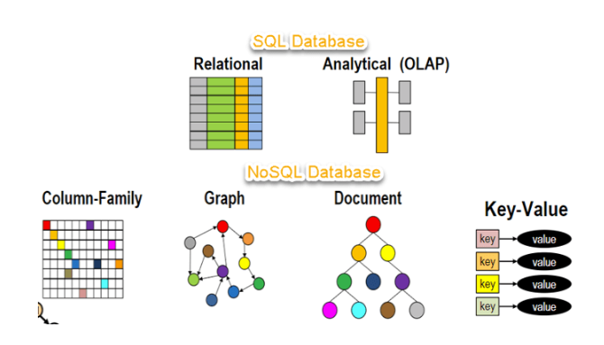
Pictorial Example
Notes:
ANDREW

Slide 16
More Kinds of Databases
Time-Series Databases
NewSQL
Software system that serves and stores time stamped data (called time-series data). This data includes server metrics, application performance monitoring data, network data, and sensor data.
Examples:
InfluxDB, TimescaleDB, Prometheus
Combines the scalability of NoSQL databases with the structure of relational databases.
Examples:
CockroachDB, VoltDB, NuoDB
Notes:
ANDREW

Slide 17
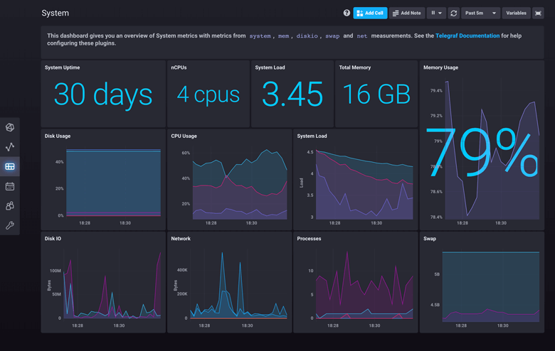
Example
Notes:
ANDREW

Slide 18

Thanks!
Have any questions? Need any help?
SwordPoro - Andrew’s discord
jarsnow - John’s discord

Slide 19
Icons pack

